Slide 1
Transit
Windsor
Capstone Project
Streamlining Operations and Improving Coordination

Slide 2
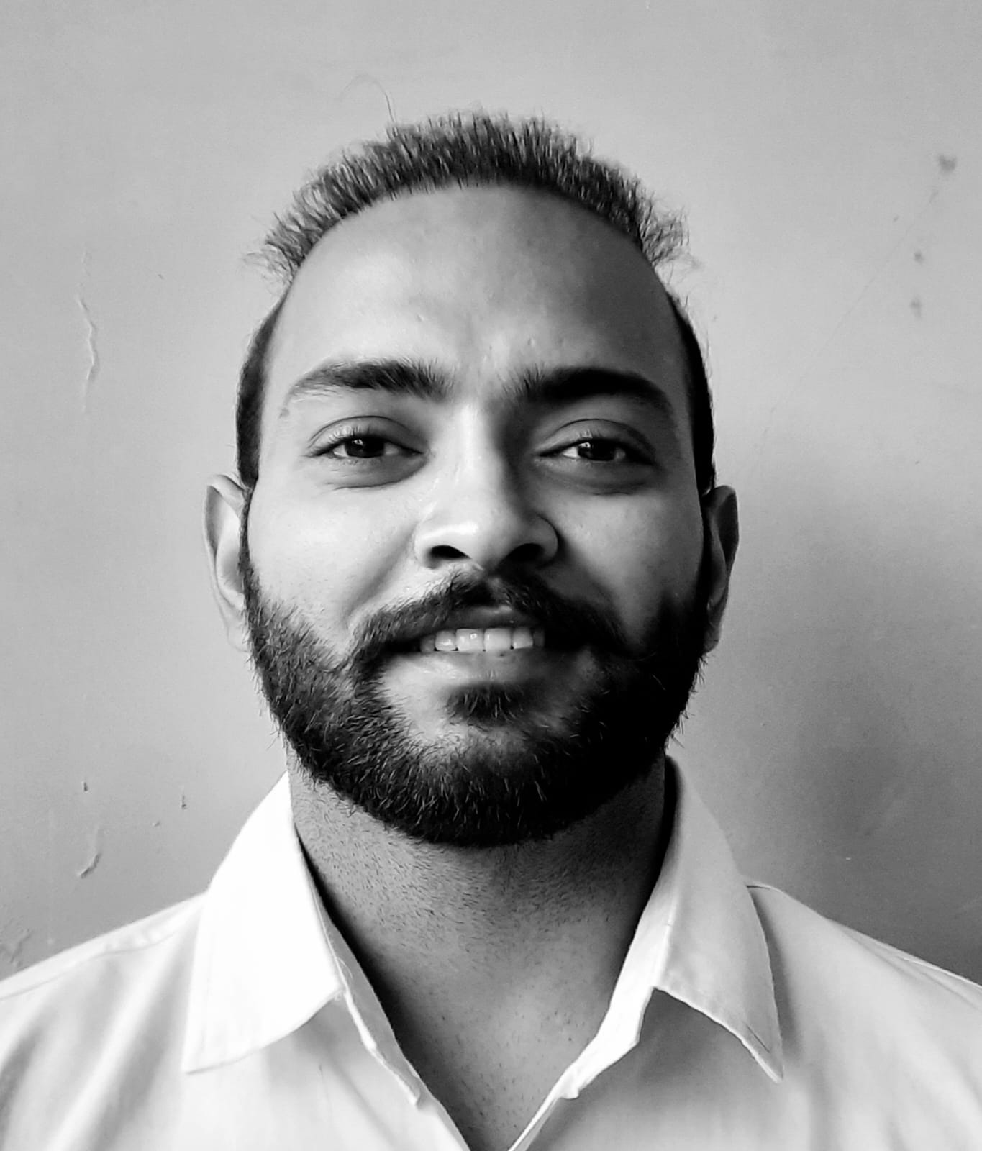
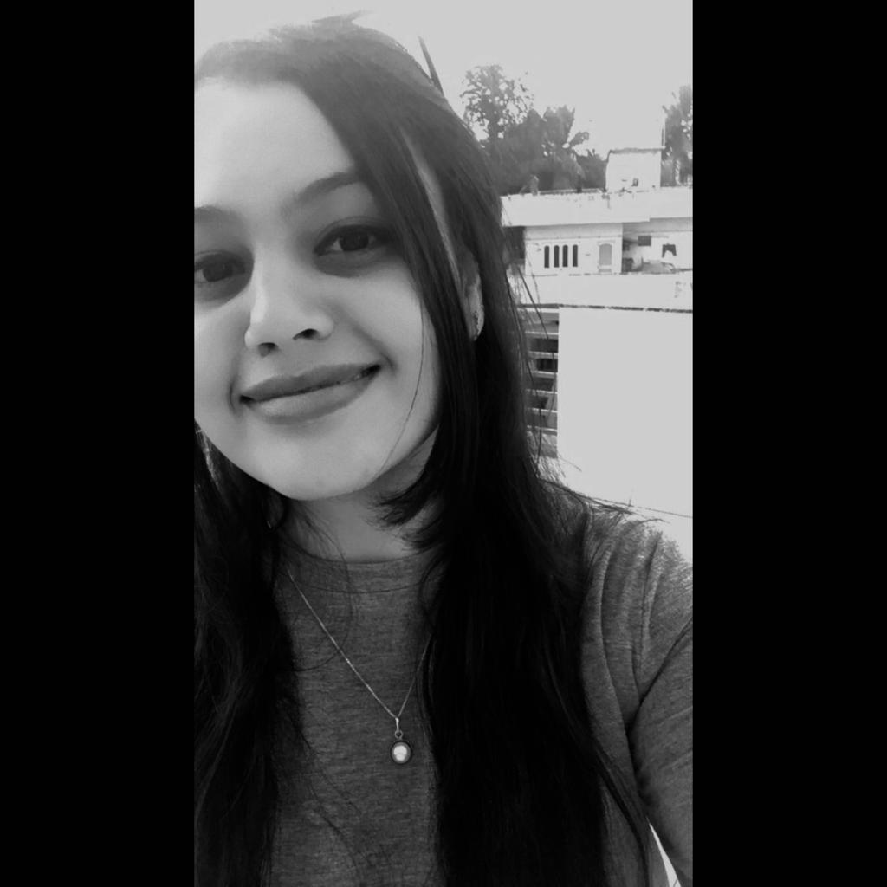
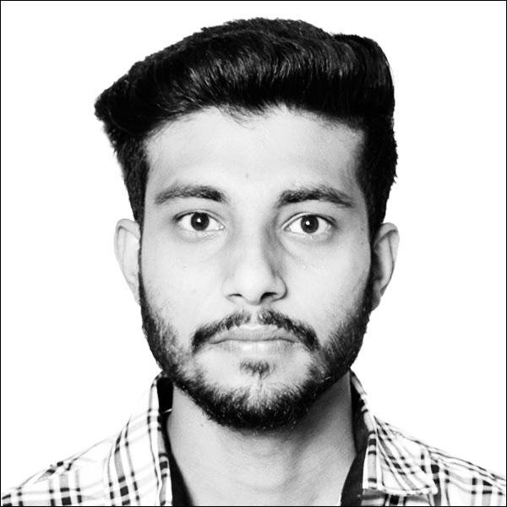
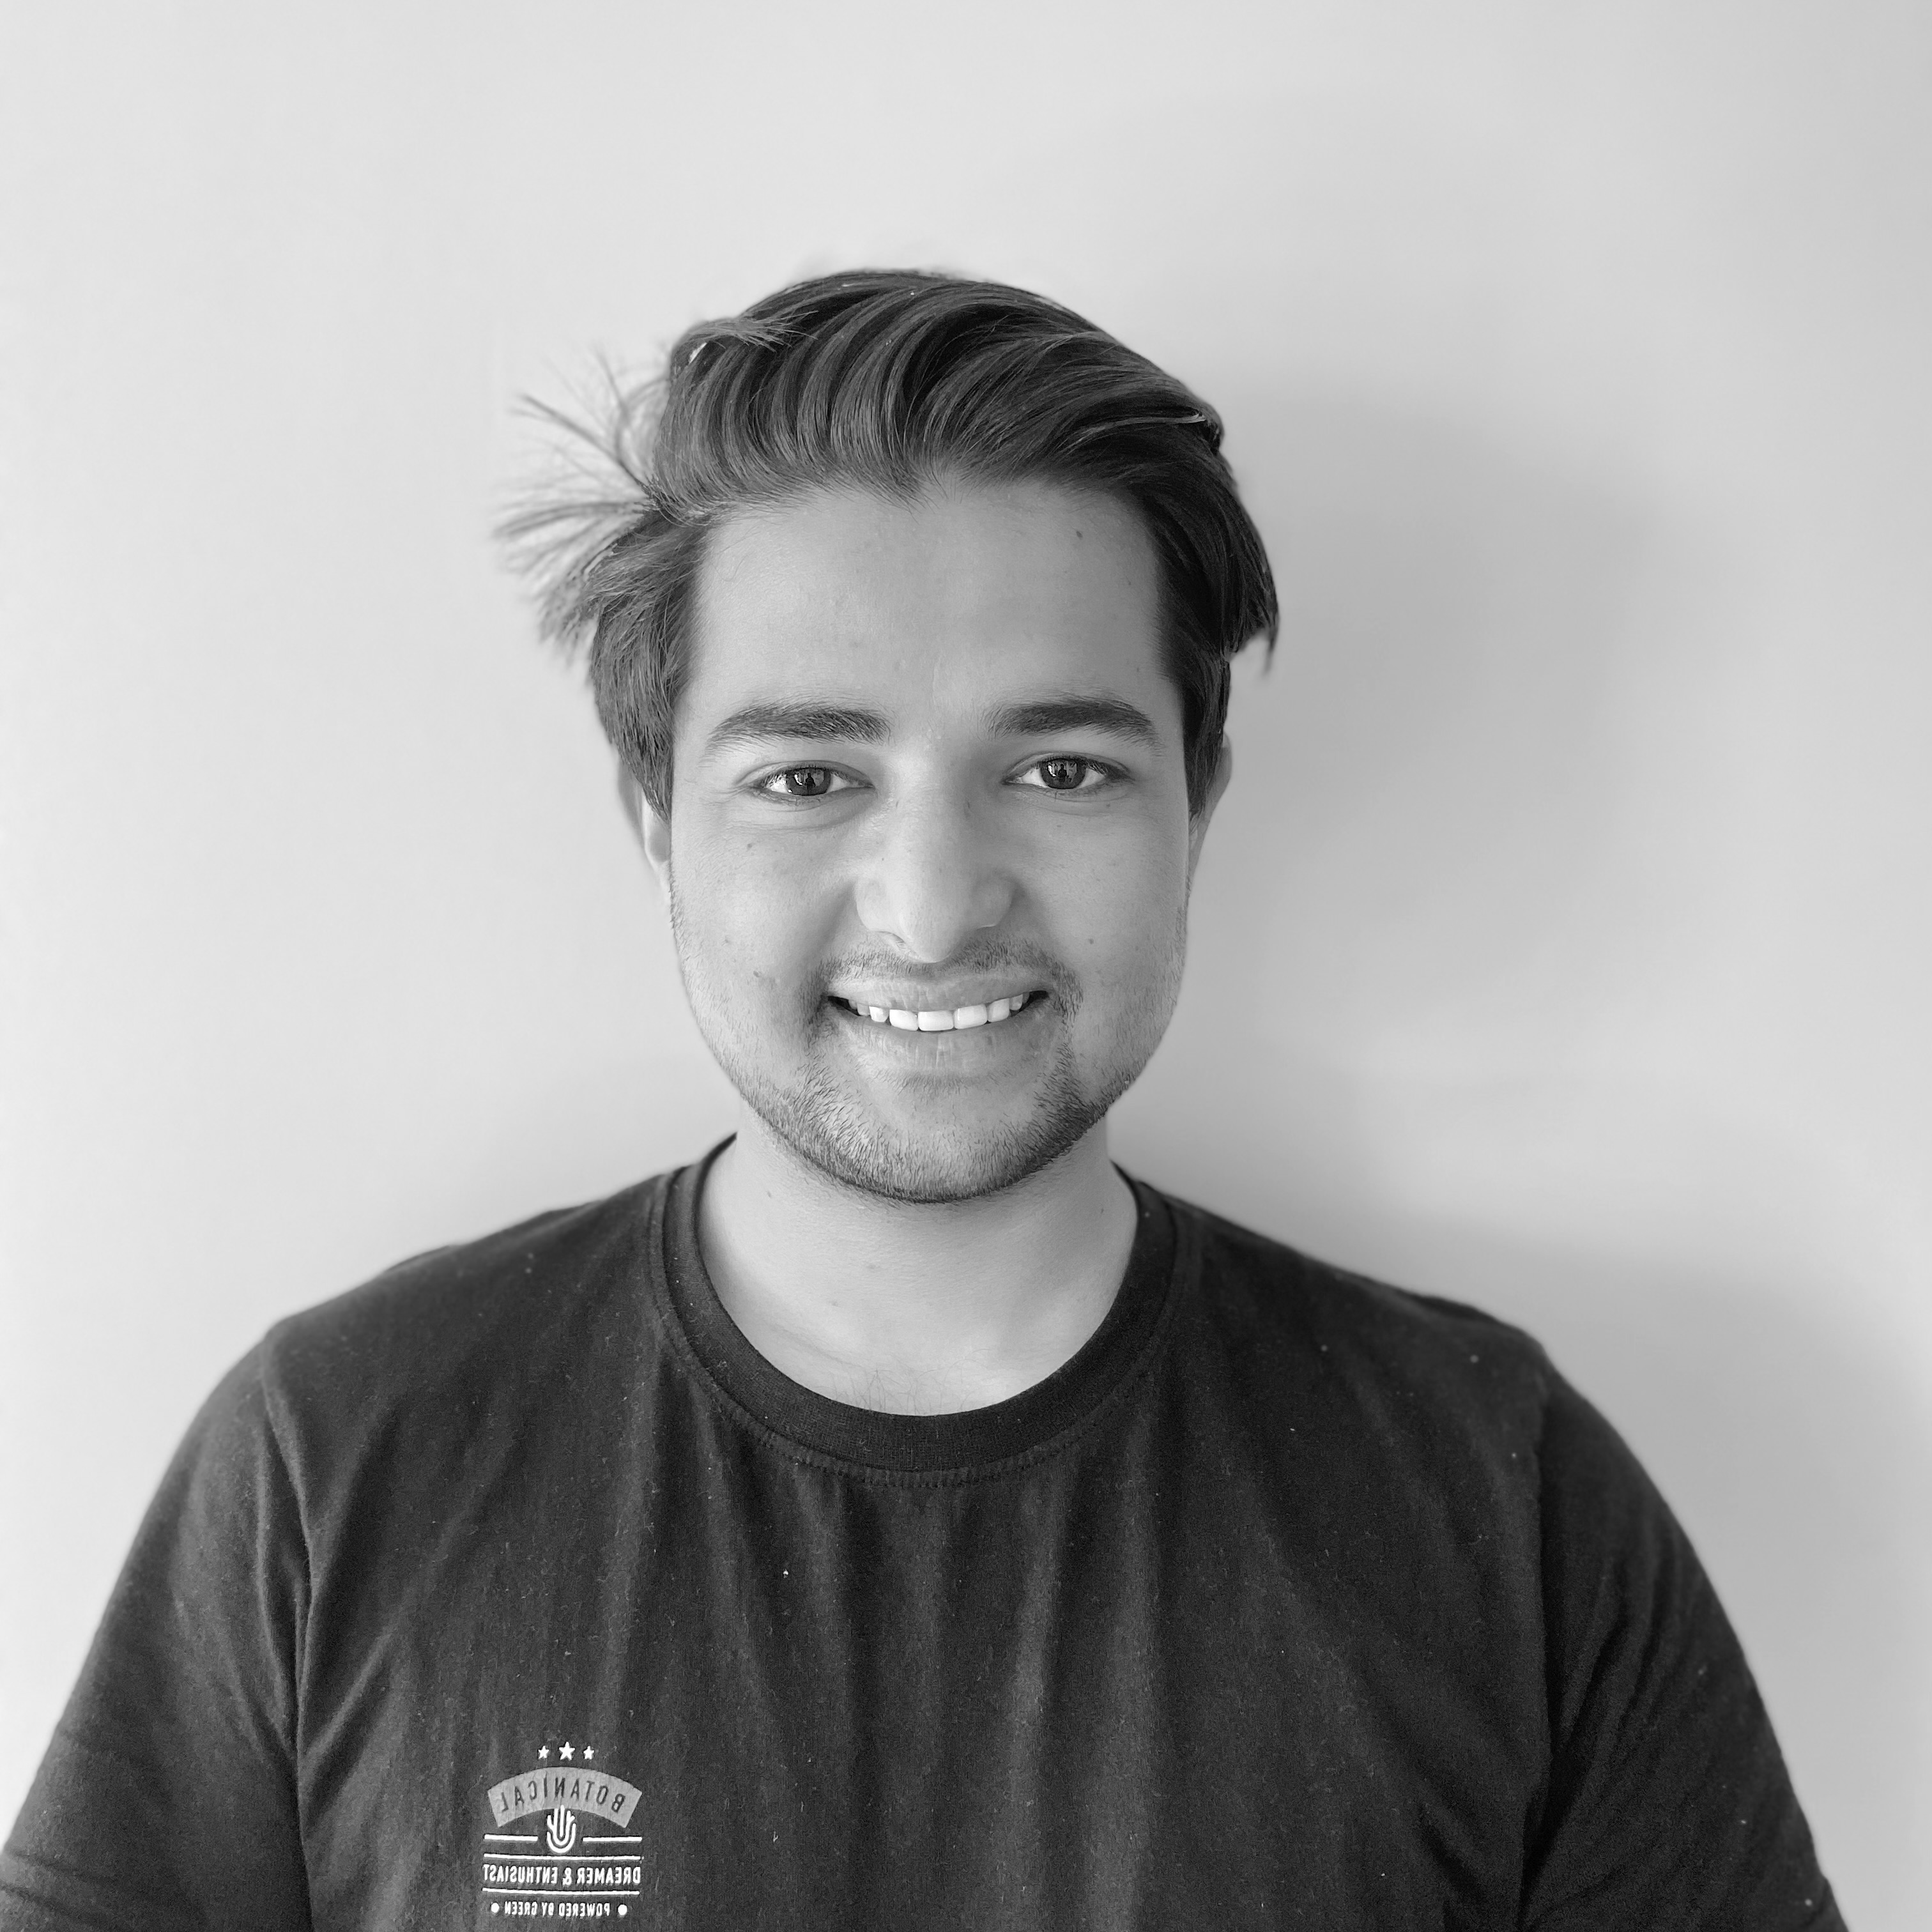
Team Three
Krupali
Raman
Abhishek
Shubham

Slide 3
Table of contents
01.
02.
03.
The project
Project Goals and Timeline
Budget
04.
05.
06.
Work done
Now
Future

Slide 4
Our Project
We're tackling the challenges of congestion, overcrowding and limited accessibility in Windsor's transit system. Our project involves research, analysis, and planning to develop solutions for a more efficient and reliable transit service.

Slide 5

Congestion and Overcrowding:
With growing urban populations and international students, Windsor transit system is becoming increasingly congested, leading to longer wait times, overcrowded vehicles, and unreliable service.
Limited accessibility:
Many transit routes are not accessible to all members of the city, particularly students and those with disabilities, who may struggle to use public transportation.

Slide 6
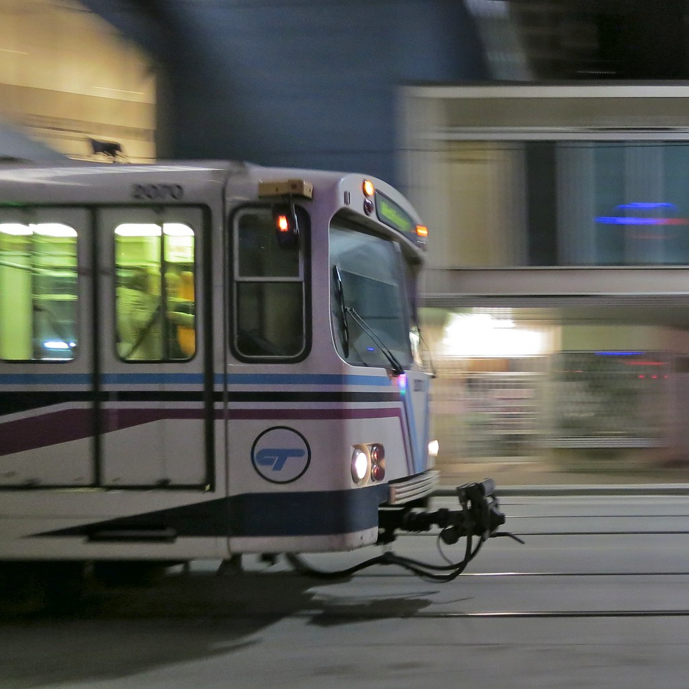
—Anthony Foxx
"Good public transportation is not just a way to get around. It can bring a city together, create jobs, and stimulate economic growth."

Slide 7
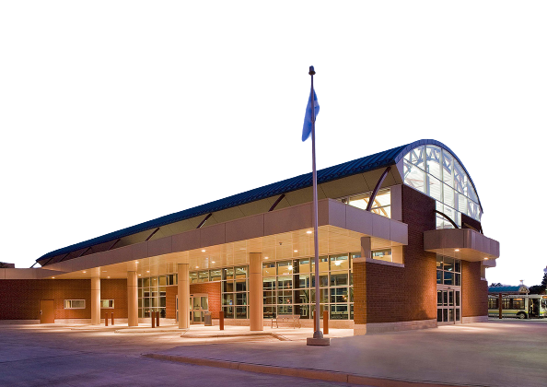
Our partner
Transit Windsor

Slide 8
Awesome numbers

Slide 9
$100 Million
Funding secured by Transit Windsor

Slide 10
1.2 Billion
Number of passenger trips in Canada for year 2022

Slide 11
$2.8 Billion
Total operating revenue for year 2022

Slide 12
Project timeline
Week 1
Week 4
Week 7
Week 12
Week 15
Team building, Research and SWOT Analysis
Formation of Business Case
Data Gathering, Cleaning and Exploration
Analysis and identifying patterns
Dashboard and Communication

Slide 13
Project goals
Descriptive Analysis
Predictive Analysis
Dashboard and Communicate findings

Slide 14
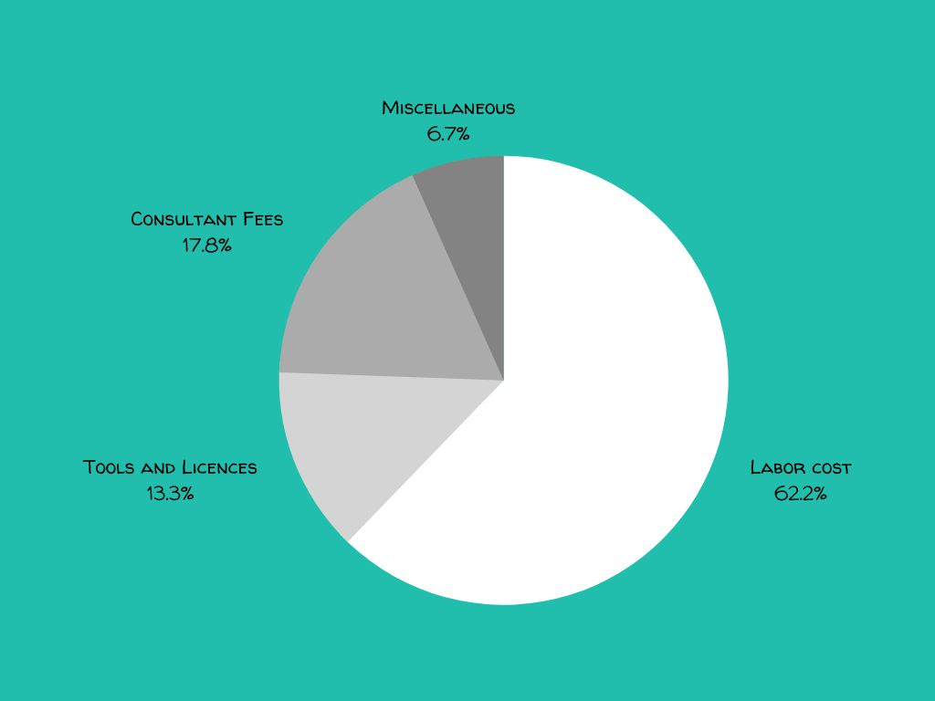
Budget
Cost Types | Amount
Labor Costs | $ 70000
Tools and Licensing | $ 15000
Consultant Fees | $ 20000
Miscellaneous | $ 7500

Slide 15
What did we work on?
Initialization
Analyze
Team building, Brainstorming & Problem statement
SWOT analysis, Data Cleaning and EDA

Slide 16
01.
Initialization
Gathering and analyzing information to inform the team's decisions and problem statement development

Slide 17
About the Initialization
Team building:
Establish strong communication and positive working relationships among team members.
Brainstorming ideas:
Generate a wide range of potential ideas and solutions to explore.
Defining the problem statement:
Clearly identify and define the specific problem the project aims to solve

Slide 18
Public Engagement
Consultation with community members and stakeholders to better understand their transportation needs, preferences, and challenges, and use that information to guide decision-making and service planning.

Slide 19
02.
Analyze
Identify patterns, trends, and relationships

Slide 20
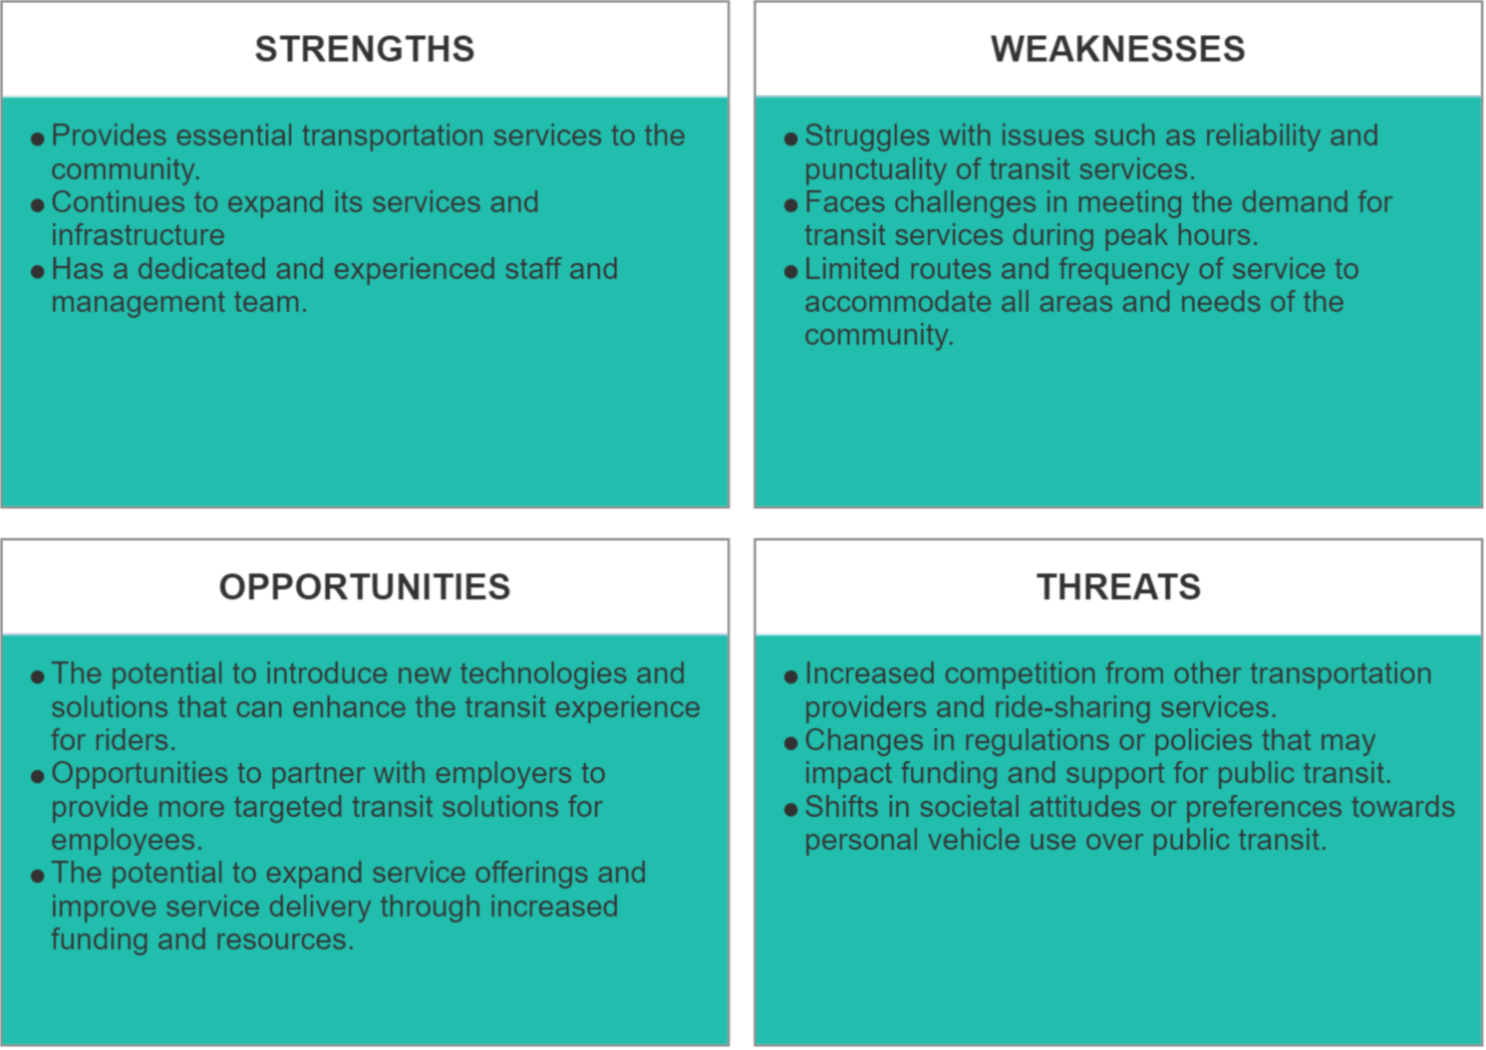
About the Analysis
We did a SWOT analysis on Transit Windsor:

Slide 21
Now
Data Cleaning
Data Exploration
Finding initial trends

Slide 22
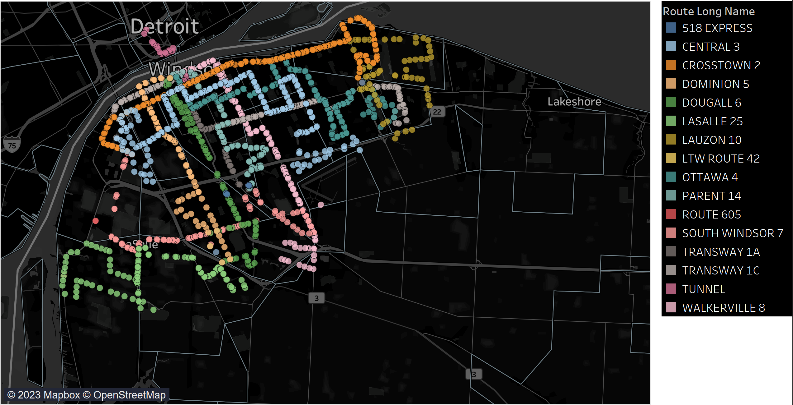
A picture is worth a thousand words

Slide 23
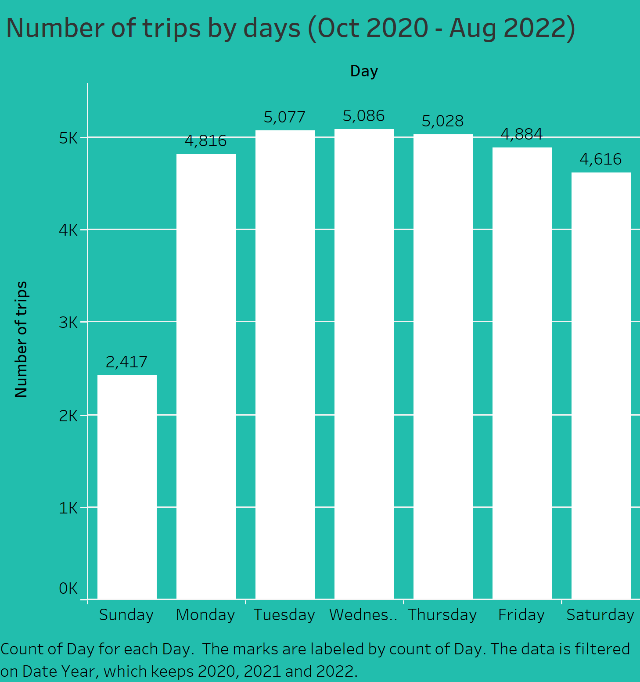

Slide 24
Future
Predict and Visualize
Create prediction models and Dashboard
Communicate
Communicate the key findings clearly to stakeholders.

Slide 25
Future projects
Strengthening partnerships: We believe we could work on strengthening partnerships with other transit agencies, businesses, and organizations to create more integrated transportation options and provide more comprehensive services to riders.
Expansion: Once Windsor Transit has been integrated within Windsor-Essex county, we would expand our scope to include other cities that may share similar transportation needs.

Slide 26
Thank you!

